Slide 1
TEJASREE M S
Madras Institute of Technology campus, Anna University
Final Project
Traffic Sign Recognition Using Deep Learning - CNN

Slide 2
PROJECT TITLE
Traffic Sign Recognition Using Deep Learning - CNN
3/21/2024 Annual Review

Slide 3


AGENDA
The agenda of the project is to build a Traffic Sign Recognition system using Convolutional Neural Networks (CNNs). This includes preprocessing a dataset of traffic sign images, constructing and training a CNN model, assessing its accuracy and robustness.
This can further be implemented for real-world applications such as autonomous driving or traffic management systems.
3/21/2024 Annual Review

Slide 4

PROBLEM STATEMENT
The project aims to develop a Traffic Sign Recognition system using Convolutional Neural Networks (CNNs) to accurately classify 43 different traffic signs. With the dataset containing various signs like speed limits, warnings, and prohibitions, the challenge lies in building a robust model capable of recognizing and distinguishing between these signs in real-time scenarios.
The objective is to create a reliable system that enhances road safety by providing accurate and timely recognition of traffic signs, aiding drivers, autonomous vehicles, and traffic management systems in making informed decisions on the road.
3/21/2024 Annual Review

Slide 5

PROJECT OVERVIEW
This project focuses on building a Traffic Sign Recognition system using Convolutional Neural Networks (CNNs). It consists of approximately 35,000 images, distributed among 43 different traffic signs. The dataset is preprocessed to enhance image quality and normalize pixel values.
The CNN model architecture includes multiple convolutional and pooling layers, followed by fully connected layers with dropout regularization to prevent overfitting. Adam optimizer is used for model compilation, and categorical cross-entropy loss is employed to measure performance.
The dataset is split into training, validation, and test sets for model evaluation. The model is trained using data augmentation techniques to improve generalization. After training, the model's performance is assessed using validation data, and the final model is evaluated on the test set.
The project culminates in the deployment of the trained model for practical use, facilitating accurate recognition of traffic signs in real-world scenarios.
3/21/2024 Annual Review

Slide 6

WHO ARE THE END USERS?
Drivers: Individuals benefit from real-time traffic sign recognition for enhanced road safety and compliance.
Autonomous Vehicle Systems: Integration enables self-driving vehicles to interpret and respond to traffic signs.
Traffic Management Authorities: Utilize systems for monitoring compliance, optimizing traffic flow, and enhancing road safety.
Pedestrians and Cyclists: Improved recognition contributes to safer interactions with vehicular traffic.
Transportation Researchers: Use system outputs for analysis, modeling, and policy development in transportation studies.
3/21/2024 Annual Review

Slide 7
YOUR SOLUTION AND ITS VALUE PROPOSITION
The project offers a Traffic Sign Recognition system utilizing Convolutional Neural Networks (CNNs) to accurately identify and interpret traffic signs from images. It involves preprocessing the dataset, training a CNN model, and deploying it for real-time recognition.
Value Proposition:
Enhanced Road Safety: Real-time recognition promotes adherence to traffic regulations, reducing accidents.
Efficient Traffic Management: Optimizes traffic flow and management by monitoring sign compliance.
Autonomous Vehicle Integration: Enables effective interpretation and response to signs, advancing autonomous driving.
Improved User Experience: Enhances safety for pedestrians, cyclists, and other road users.
Research and Analysis: Supports transportation studies with valuable data for analysis and policy development.
3/21/2024 Annual Review

Slide 8

THE WOW IN YOUR SOLUTION
High Accuracy: Achieving a remarkable model accuracy of 97.91% showcases the effectiveness and reliability of our Traffic Sign Recognition system.
Real-Time Recognition: Our system provides instantaneous recognition of traffic signs, ensuring quick and accurate responses to changing road conditions, thereby enhancing road safety.
Versatile Application: With seamless integration into autonomous vehicles, efficient traffic management systems, and pedestrian safety initiatives, our solution addresses diverse transportation needs.
Future-Ready Technology: By leveraging cutting-edge CNNs and advanced image processing techniques, our project exemplifies innovation in the field of transportation technology, paving the way for safer and smarter urban mobility solutions.
3/21/2024 Annual Review
8

Slide 9
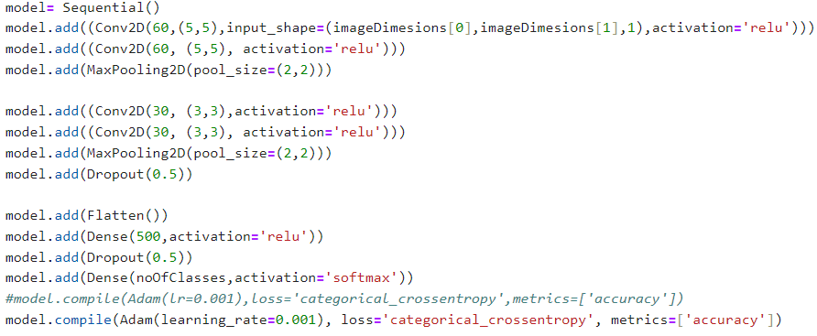
MODELLING
This code defines a Convolutional Neural Network (CNN) model using TensorFlow's Keras API. The model architecture consists of several convolutional layers followed by max-pooling layers for feature extraction, dropout layers for regularization, and dense layers for classification. The model is compiled with the Adam optimizer and categorical cross-entropy loss function. This setup aims to classify traffic sign images efficiently and accurately.
9

Slide 10
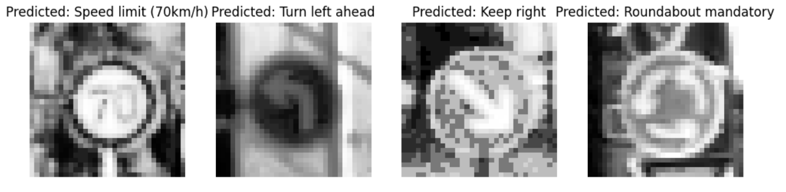
RESULTS
Obtained Model Accuracy:
0.9791
Demo Video Link
https://drive.google.com/file/d/1pDUAV7hNARBqN2a21_bdk-vNZZbPiC0B/view?usp=drive_link
3/21/2024 Annual Review
10

Slide 11
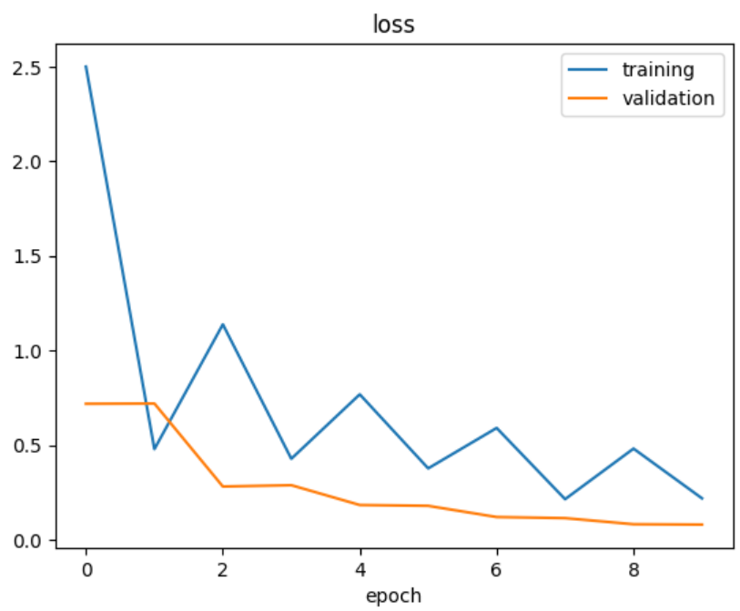
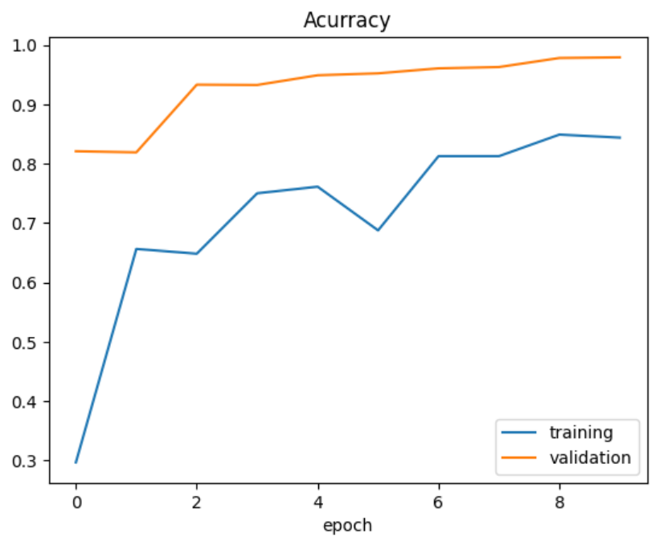
ACCURACY
3/21/2024 Annual Review
11

